Slide 1
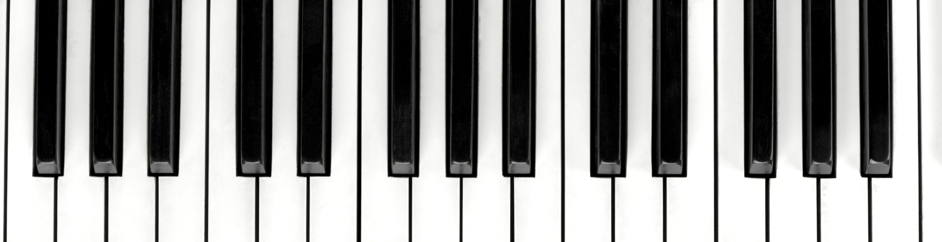
Query by Playing

Slide 2
The Problem
Have you ever imagined being able to play a song and during this performance the computer will already be able to give you some results of scores containing songs similar to the music you are playing?
Is there a way to make the computer understand the musical rules applied by a musician during a musical performance and identify them?
Search musics in a database , playing a specific song. That´s it!

Slide 3
The Target
This research also arose from the curiosity to know how we can make the computer understand the musical art!
Where the musician have the feeling that the system is REALLY understanding the music!

Slide 4
The Passion!
From this curiosity, it was discovered that, exists a specific scientific branch of music research called MIR - Music Information Retrieval and there is a considerable number of researchers with the objective of answering these and several other questions and hypotheses related to Music Similarity and Melodic Similarity.
I Literally Fell in love with this!

Slide 5
QBP – Query by Playing?
Many researchs of Music similarity are identifyed by the “Query-By” keyword , the most famous is Query-by-Humming and Query-By-Example.
What makes Query-By-Playing Different?
Instruments.
Real-Time.
Intuitive.

Slide 6
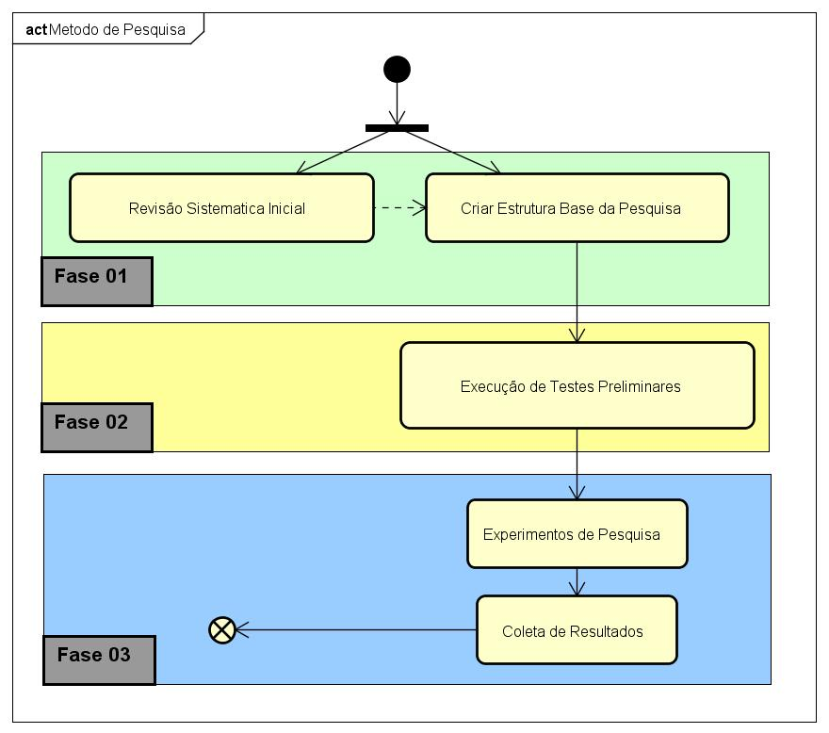
The Research
Sistematic Review & Structure
Preliminary Tests
Experiments & Results

Slide 7
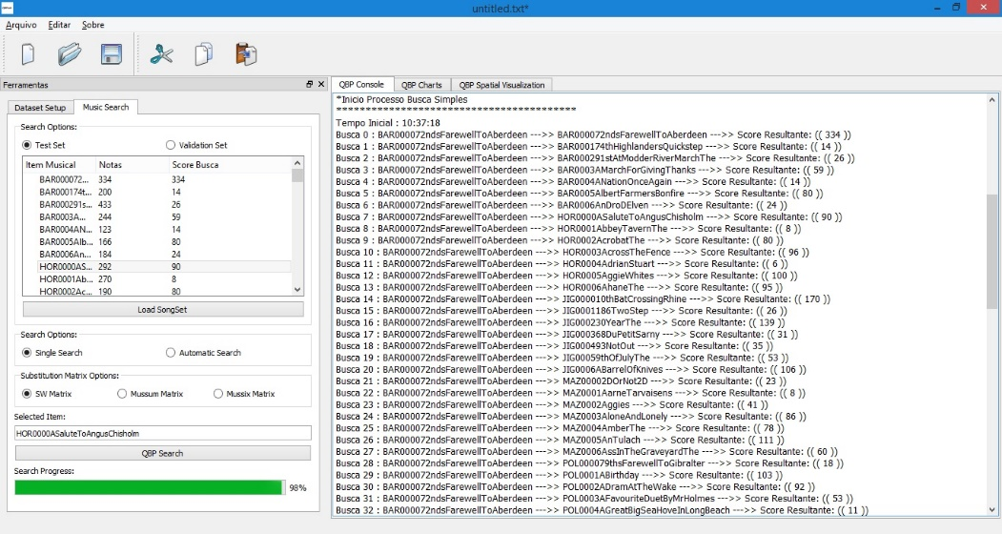
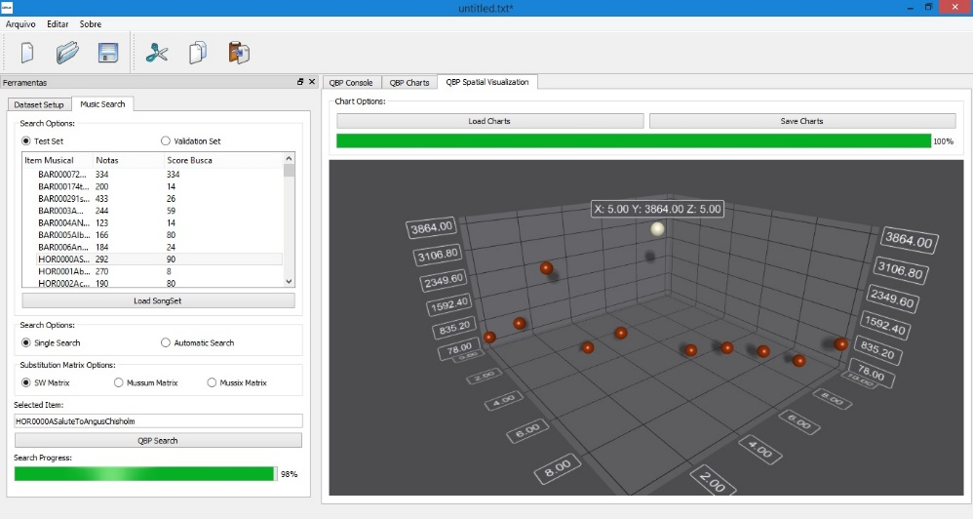
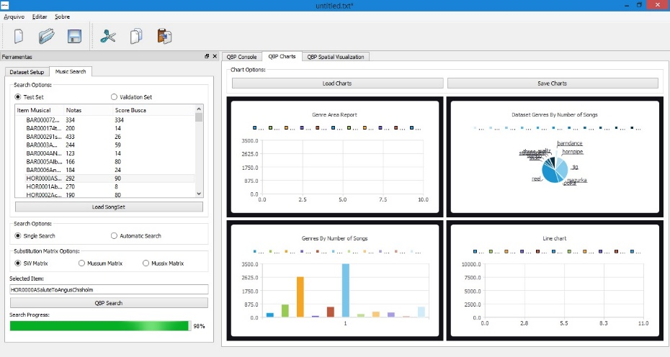
Preliminary Results
Actually the research are in Phase 03 where:
A complete research enviroment are developed/prepeared for the research (QBPLab)
Most of Limitations in the similarity algorithm are eliminated.
Must start the phase 03 -experiments and results collection.

Slide 8
Considerations
This research will be dedicated to all the musician scientists who, someday, dreamed of making the machine understand their art.

